Slide 1
Pairwise Sequence Alignment
Stuart M. Brown
NYU School of Medicine
w/ slides byFourie Joubert

Slide 2
Protein Evolution
“For many protein sequences, evolutionary history can be traced back 1-2 billion years”
-William Pearson
When we align sequences, we assume that they share a common ancestor
  They are then homologous
Protein fold is much more conserved than protein sequence
DNA sequences tend to be less informative than protein sequences
Notes:
Protein sequencce comparison and protein evolution ISMB 2000

Slide 3
Definition
Homology: related by descent
Homologous sequence positions
ATTGCGC
→ ATTGCGC
ATTGCGC
→
ATTGCGC
AT-CCGC
C
→ ATCCGC

Slide 4
Orthologous and paralogous
Orthologous sequences differ because they are found in different species (a speciation event)
Paralogous sequences differ due to a gene duplication event
Sequences may be both orthologous and paralogous

Slide 5
Pairwise Alignment
The alignment of two sequences (DNA or protein) is a relatively straightforward computational problem.
  There are lots of possible alignments.
Two sequences can always be aligned.
Sequence alignments have to be scored.
Often there is more than one solution with the same score.

Slide 6
Methods of Alignment
By hand - slide sequences on two lines of a word processor
Dot plot
  with windows
Rigorous mathematical approach
  Dynamic programming (slow, optimal)
Heuristic methods (fast, approximate)
  BLAST and FASTA
    Word matching and hash tables0

Slide 7
Align by Hand
GATCGCCTA_TTACGTCCTGGAC <--
--> AGGCATACGTA_GCCCTTTCGC
You still need some kind of scoring system to find the best alignment

Slide 8
Percent Sequence Identity
The extent to which two nucleotide or amino acid sequences are invariant
A C C T G A G – A G
A C G T G – G C A G
mismatch
indel
70% identical

Slide 9
Dotplot:
A dotplot gives an overview of all possible alignments
A    
T    
T    
C   
A    
C   
A    
T    
A    
T A C A T T A C G T A C
Sequence 2
Sequence 1

Slide 10
Dotplot:
In a dotplot each diagonal corresponds to a possible (ungapped) alignment
A    
T    
T    
C   
A    
C   
A    
T    
A    
T A C A T T A C G T A C
Sequence 2
Sequence 1
One possible alignment:
T A C A T T A C G T A C
A T A C A C T T A

Slide 11

Insertions / Deletions in a Dotplot
Sequence 2
T
A
C
T
G
T
C
A
T
T A C T G T T C A T
Sequence 1
T A C T G - T C A T
| | | | | | | | |
T A C T G T T C A T

Slide 12
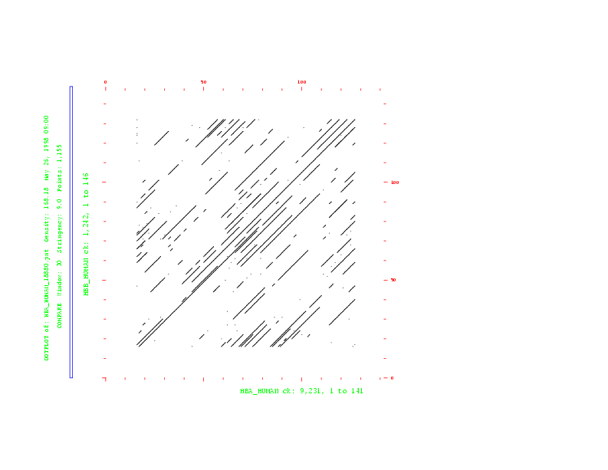
Dotplot
(Window = 130 / Stringency = 9)
Hemoglobin
β-chain
Hemoglobin α-chain

Slide 13
Word Size Algorithm
T A C G G T A T G
A C A G T A T C
Word Size = 3
C
T
A
T 
G
A
C
A
T A C G G T A T G
T A C G G T A T G
A C A G T A T C
T A C G G T A T G
A C A G T A T C
T A C G G T A T G
A C A G T A T C
✴

Slide 14
Window / Stringency
Score = 11
PTHPLASKTQILPEDLASEDLTI
✴
PTHPLAGERAIGLARLAEEDFGM
Scoring Matrix Filtering
Score = 11
Matrix: PAM250
Window = 12
Stringency = 9
PTHPLASKTQILPEDLASEDLTI
✴
PTHPLAGERAIGLARLAEEDFGM
Score = 7
PTHPLASKTQILPEDLASEDLTI
PTHPLAGERAIGLARLAEEDFGM

Slide 15
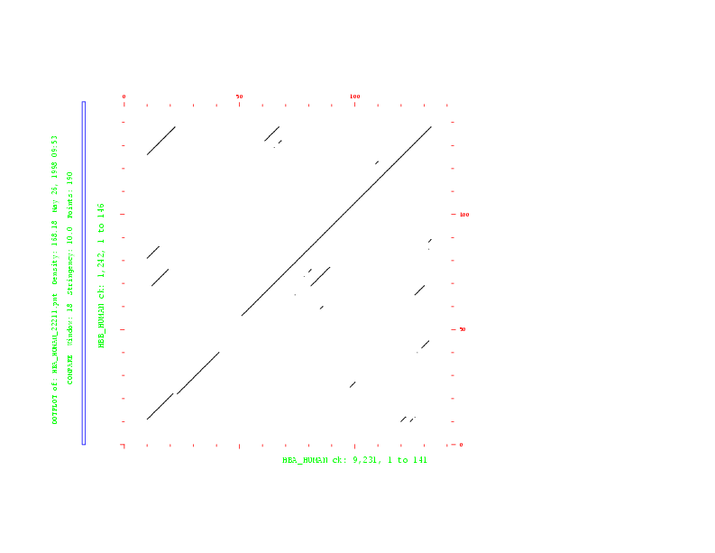
Dotplot
(Window = 18 / Stringency = 10)
Hemoglobin
β-chain
Hemoglobin α-chain

Slide 16
Considerations
The window/stringency method is more sensitive than the wordsize
method (ambiguities are permitted).
The smaller the window, the larger the weight of statistical
(unspecific) matches.
With large windows the sensitivity for short sequences is reduced.
Insertions/deletions are not treated explicitly.

Slide 17
Alignment methods
Rigorous algorithms = Dynamic Programming
  Needleman-Wunsch (global)
  Smith-Waterman (local)
Heuristic algorithms
(faster but approximate)
    BLAST
    FASTA

Slide 18
Basic principles of dynamic programming
    - Creation of an alignment path matrix
    - Stepwise calculation of score values
    - Backtracking (evaluation of the optimal path)

Slide 19
Dynamic Programming
Dynamic Programming is a very general programming technique.
It is applicable when a large search space can be structured into a succession of stages, such that:
  the initial stage contains trivial solutions to sub-problems
  each partial solution in a later stage can be calculated by recurring a fixed number of partial solutions in an earlier stage
  the final stage contains the overall solution

Slide 20
Creation of an alignment path matrix
Idea:
Build up an optimal alignment using previous solutions for optimal alignments of smaller subsequences
Construct matrix F indexed by i and j (one index for each sequence)
F(i,j) is the score of the best alignment between the initial segment x_{1...i} of x up to x_{i} and the initial segment y_{1...j} of y up to y_{j}
Build F(i,j) recursively beginning with F(0,0) = 0

Slide 21
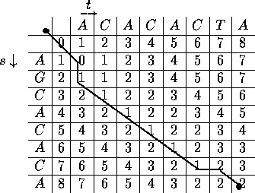

Slide 22
Creation of an alignment path matrix
If F(i-1,j-1), F(i-1,j) and F(i,j-1) are known we can calculate F(i,j)
Three possibilities:
  x_{i} and y_{j} are aligned, F(i,j) = F(i-1,j-1) + s(x_{i} ,y_{j})
  x_{i} is aligned to a gap, F(i,j) = F(i-1,j) - d
  y_{j} is aligned to a gap, F(i,j) = F(i,j-1) - d
The best score up to (i,j) will be the largest of the three options

Slide 23
Backtracking
H E A G A W G H E E
0 -8 -16 -24 -32 -40 -48 -56 -64 -72 -80
P -8 -2 -9 -17 -25 -33 -42 -49 -57 -65 -73
A -16 -10 -3 -4 -12 -20 -28 -36 -44 -52 -60
W -24 -18 -11 -6 -7 -15 -5 -13 -21 -29 -37
H -32 -14 -18 -13 -8 -9 -13 -7 -3 -11 -19
E -40 -22 -8 -16 -16 -9 -12 -15 -7 3 -5
A -48 -30 -16 -3 -11 -11 -12 -12 -15 -5 2
E -56 -38 -24 -11 -6 -12 -14 -15 -12 -9 1
0
-8
-16
-17
-25
-20
-5
-13
-3
3
-5
1
H
-
E
-
A
P
G
-
G
-
H
H
E
E
A
A
-
A
Optimal global alignment:
W
W
E
E

Slide 24
Global vs. Local Alignments
Global alignment algorithms start at the beginning of two sequences and add gaps to each until the end of one is reached.
Local alignment algorithms finds the region (or regions) of highest similarity between two sequences and build the alignment outward from there.

Slide 25
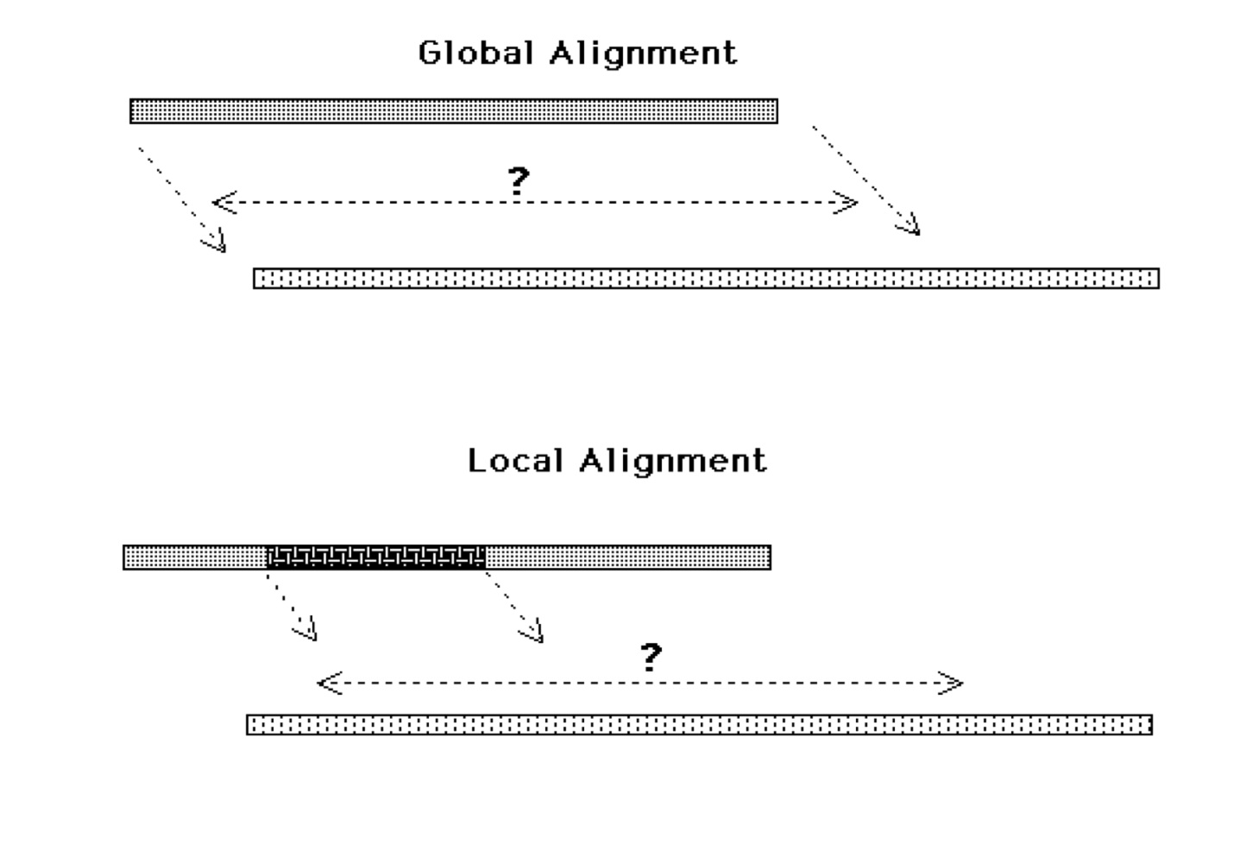

Slide 26
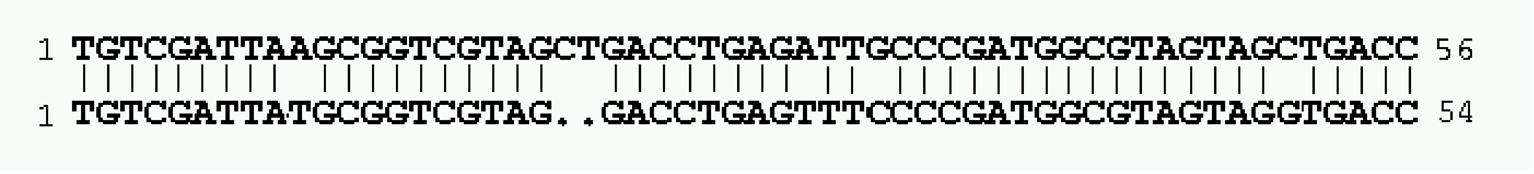
Global Alignment
Two closely related sequences:
needle (Needleman & Wunsch) creates an end-to-end alignment.

Slide 27
Global Alignment
Two sequences sharing several regions of local similarity:
1 AGGATTGGAATGCTCAGAAGCAGCTAAAGCGTGTATGCAGGATTGGAATTAAAGAGGAGGTAGACCG.... 67
|||||||||||||| | | | |||| || | | | ||
1 AGGATTGGAATGCTAGGCTTGATTGCCTACCTGTAGCCACATCAGAAGCACTAAAGCGTCAGCGAGACCG 70

Slide 28
Global Alignment (Needleman -Wunsch)
The the Needleman-Wunsch algorithm creates a global alignment over the length of both sequences (needle)
Global algorithms are often not effective for highly diverged sequences - do not reflect the biological reality that two sequences may only share limited regions of conserved sequence.
  Sometimes two sequences may be derived from ancient recombination events where only a single functional domain is shared.
Global methods are useful when you want to force two sequences to align over their entire length

Slide 29
Local Alignment
(Smith-Waterman)
Local alignment
  Identify the most similar sub-region shared between two sequences
  Smith-Waterman
  EMBOSS: water

Slide 30
Parameters of Sequence Alignment
Scoring Systems:
Each symbol pairing is assigned a numerical value, based on a symbol comparison table.
Gap Penalties:
Opening: The cost to introduce a gap
Extension: The cost to elongate a gap

Slide 31
DNA Scoring Systems
-very simple
Sequence 1
Sequence 2
actaccagttcatttgatacttctcaaa
taccattaccgtgttaactgaaaggacttaaagact
A G C T
A 1 0 0 0
G 0 1 0 0
C 0 0 1 0
T 0 0 0 1
Match: 1
Mismatch: 0
Score = 5

Slide 32
Protein Scoring Systems
Sequence 1
Sequence 2
PTHPLASKTQILPEDLASEDLTI
PTHPLAGERAIGLARLAEEDFGM
C S T P A G N D . .
C 9
S -1 4
T -1 1 5
P -3 -1 -1 7
A 0 1 0 -1 4
G -3 0 -2 -2 0 6
N -3 1 0 -2 -2 0 5
D -3 0 -1 -1 -2 -1 1 6
.
.
Scoring
matrix
C S T P A G N D . .
C 9
S -1 4
T -1 1 5
P -3 -1 -1 7
A 0 1 0 -1 4
G -3 0 -2 -2 0 6
N -3 1 0 -2 -2 0 5
D -3 0 -1 -1 -2 -1 1 6
.
.
T:G = -2
T:T = 5
Score = 48

Slide 33
Protein Scoring Systems
Amino acids have different biochemical and physical properties
that influence their relative replaceability in evolution.
tiny
P
aliphatic
C
small
S+S
G
I
A
G
S
V
C
N
L
SH
T
D
hydrophobic
M
Y
K
E
F
Q
W
H
R
positive
aromatic
polar
charged

Slide 34
Protein Scoring Systems
Scoring matrices reflect:
  # of mutations to convert one to another
  chemical similarity
  – observed mutation frequencies
  – the probability of occurrence of each amino acid
Widely used scoring matrices:
  PAM
  BLOSUM

Slide 35
PAM matrices
Family of matrices PAM 80, PAM 120,
PAM 250
The number with a PAM matrix represents the evolutionary distance between the sequences on which the matrix is based
Greater numbers denote greater distances

Slide 36
PAM (Percent Accepted Mutations) matrices
The numbers of replacements were used to compute a so-called
PAM-1 matrix.
The PAM-1 matrix reflects an average change of 1% of all amino
acid positions. PAM matrices for larger evolutionary distances can
be extrapolated from the PAM-1 matrix.
PAM250 = 250 mutations per 100 residues.
Greater numbers mean bigger evolutionary distance
  .

Slide 37
PAM (Percent Accepted Mutations) matrices
Derived from global alignments of protein families . Family members
share at least 85% identity (Dayhoff et al., 1978).
Construction of phylogenetic tree and ancestral sequences of
each protein family
Computation of number of replacements for each pair of amino acids

Slide 38
PAM 250
A R N D C Q E G H I L K M F P S T W Y V B Z
A 2 -2 0 0 -2 0 0 1 -1 -1 -2 -1 -1 -3 1 1 1 -6 -3 0 2 1
R -2 6 0 -1 -4 1 -1 -3 2 -2 -3 3 0 -4 0 0 -1 2 -4 -2 1 2
N 0 0 2 2 -4 1 1 0 2 -2 -3 1 -2 -3 0 1 0 -4 -2 -2 4 3
D 0 -1 2 4 -5 2 3 1 1 -2 -4 0 -3 -6 -1 0 0 -7 -4 -2 5 4
C -2 -4 -4 -5 12 -5 -5 -3 -3 -2 -6 -5 -5 -4 -3 0 -2 -8 0 -2 -3 -4
Q 0 1 1 2 -5 4 2 -1 3 -2 -2 1 -1 -5 0 -1 -1 -5 -4 -2 3 5
E 0 -1 1 3 -5 2 4 0 1 -2 -3 0 -2 -5 -1 0 0 -7 -4 -2 4 5
G 1 -3 0 1 -3 -1 0 5 -2 -3 -4 -2 -3 -5 0 1 0 -7 -5 -1 2 1
H -1 2 2 1 -3 3 1 -2 6 -2 -2 0 -2 -2 0 -1 -1 -3 0 -2 3 3
I -1 -2 -2 -2 -2 -2 -2 -3 -2 5 2 -2 2 1 -2 -1 0 -5 -1 4 -1 -1
L -2 -3 -3 -4 -6 -2 -3 -4 -2 2 6 -3 4 2 -3 -3 -2 -2 -1 2 -2 -1
K -1 3 1 0 -5 1 0 -2 0 -2 -3 5 0 -5 -1 0 0 -3 -4 -2 2 2
M -1 0 -2 -3 -5 -1 -2 -3 -2 2 4 0 6 0 -2 -2 -1 -4 -2 2 -1 0
F -3 -4 -3 -6 -4 -5 -5 -5 -2 1 2 -5 0 9 -5 -3 -3 0 7 -1 -3 -4
P 1 0 0 -1 -3 0 -1 0 0 -2 -3 -1 -2 -5 6 1 0 -6 -5 -1 1 1
S 1 0 1 0 0 -1 0 1 -1 -1 -3 0 -2 -3 1 2 1 -2 -3 -1 2 1
T 1 -1 0 0 -2 -1 0 0 -1 0 -2 0 -1 -3 0 1 3 -5 -3 0 2 1
W -6 2 -4 -7 -8 -5 -7 -7 -3 -5 -2 -3 -4 0 -6 -2 -5 17 0 -6 -4 -4
Y -3 -4 -2 -4 0 -4 -4 -5 0 -1 -1 -4 -2 7 -5 -3 -3 0 10 -2 -2 -3
V 0 -2 -2 -2 -2 -2 -2 -1 -2 4 2 -2 2 -1 -1 -1 0 -6 -2 4 0 0
B 2 1 4 5 -3 3 4 2 3 -1 -2 2 -1 -3 1 2 2 -4 -2 0 6 5
Z 1 2 3 4 -4 5 5 1 3 -1 -1 2 0 -4 1 1 1 -4 -3 0 5 6
C
W
W
-8
17

Slide 39
PAM - limitations
Based on only one original dataset
Examines proteins with few differences (85% identity)
Based mainly on small globular proteins so the matrix is biased

Slide 40
BLOSUM matrices
Different BLOSUMn matrices are calculated independently from BLOCKS (ungapped local alignments)
BLOSUMn is based on a cluster of BLOCKS of sequences that share at least n percent identity
BLOSUM62 represents closer sequences than BLOSUM45

Slide 41
BLOSUM (Blocks Substitution Matrix)
Derived from alignments of domains of distantly related
proteins (Henikoff & Henikoff,1992).
Occurrences of each amino acid pair
in each column of each block alignment
is counted.
The numbers derived from all blocks were
used to compute the BLOSUM matrices.
A
A
C
E
C
A
A
C
E
C
A - C = 4
A - E = 2
C - E = 2
A - A = 1
C - C = 1

Slide 42
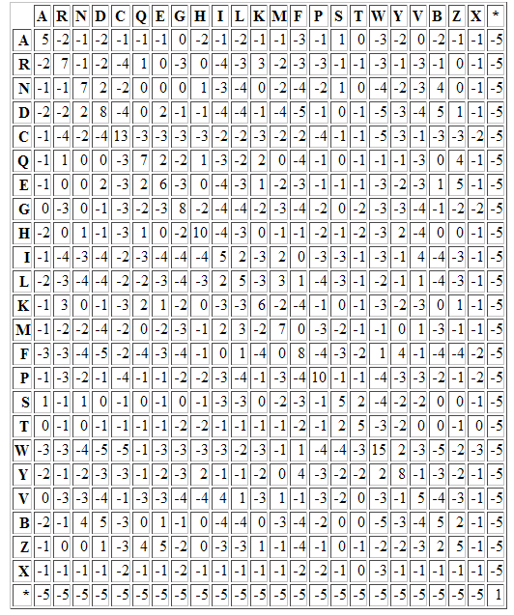
The Blosum50 Scoring Matrix

Slide 43
BLOSUM (Blocks Substitution Matrix)
Sequences within blocks are clustered according to their level of identity.
Clusters are counted as a single sequence.
Different BLOSUM matrices differ in the percentage of sequence identity
used in clustering.
The number in the matrix name (e.g. 62 in BLOSUM62) refers to the
percentage of sequence identity used to build the matrix.
Greater numbers mean smaller evolutionary distance.

Slide 44
PAM Vs. BLOSUM
PAM100 = BLOSUM90
PAM120 = BLOSUM80
PAM160 = BLOSUM60
PAM200 = BLOSUM52
PAM250 = BLOSUM45
More distant sequences
  PAM120 for general use
  PAM60 for close relations
  PAM250 for distant relations
  BLOSUM62 for general use
  BLOSUM80 for close relations
  BLOSUM45 for distant relations

Slide 45
TIPS on choosing a scoring matrix
Generally, BLOSUM matrices perform better than PAM matrices
for local similarity searches (Henikoff & Henikoff, 1993).
When comparing closely related proteins one should use lower
PAM or higher BLOSUM matrices, for distantly related proteins
higher PAM or lower BLOSUM matrices.
For database searching the commonly used matrix is BLOSUM62.

Slide 46
Scoring Insertions and Deletions
A T G T A A T G C A
T A T G T G G A A T G A
A T G T - - A A T G C A
T A T G T G G A A T G A
insertion / deletion
The creation of a gap is penalized with a negative score value.

Slide 47
Why Gap Penalties?
Gaps not permitted Score: 0
1 GTGATAGACACAGACCGGTGGCATTGTGG 29
||| | | ||| | || || |
1 GTGTCGGGAAGAGATAACTCCGATGGTTG 29
Match = 5
Mismatch = -4
Gaps allowed but not penalized Score: 88
1 GTG.ATAG.ACACAGA..CCGGT..GGCATTGTGG 29
||| || | | | ||| || | | || || |
1 GTGTAT.GGA.AGAGATACC..TCCG..ATGGTTG 29

Slide 48
Why Gap Penalties?
The optimal alignment of two similar sequences is usually that which
    maximizes the number of matches and
    minimizes the number of gaps.
    There is a tradeoff between these two
      - adding gaps reduces mismatches
Permitting the insertion of arbitrarily many gaps can lead to high scoring alignments of non-homologous sequences.
Penalizing gaps forces alignments to have relatively few gaps.

Slide 49
Gap Penalties
How to balance gaps with mismatches?
Gaps must get a steep penalty, or else you’ll end up with nonsense alignments.
In real sequences, muti-base (or amino acid) gaps are quit common
    genetic insertion/deletion events
“Affine” gap penalties give a big penalty for each new gap, but a much smaller “gap extension” penalty.

Slide 50
Scoring Insertions and Deletions
match = 1
mismatch = 0
Total Score: 4
A T G T T A T A C
T A T G T G C G T A T A
Total Score: 8 - 3.2 = 4.8
A T G T - - - T A T A C
T A T G T G C G T A T A
Gap parameters:
d = 3 (gap opening)
e = 0.1 (gap extension)
g = 3 (gap lenght)
γ(g) = -3 - (3 -1) 0.1 = -3.2
insertion / deletion

Slide 51
Modification of Gap Penalties
Score Matrix: BLOSUM62
gap opening penalty = 3
gap extension penalty = 0.1
score = 6.3
1 ...VLSPADKFLTNV 12
||||
1 VFTELSPAKTV.... 11
gap opening penalty = 0
gap extension penalty = 0.1
score = 11.3
1 V...LSPADKFLTNV 12
| |||| | | |
1 VFTELSPA.K..T.V 11

